Slide 1
Communication network Measurement Tools
Lecture TWO

Slide 2
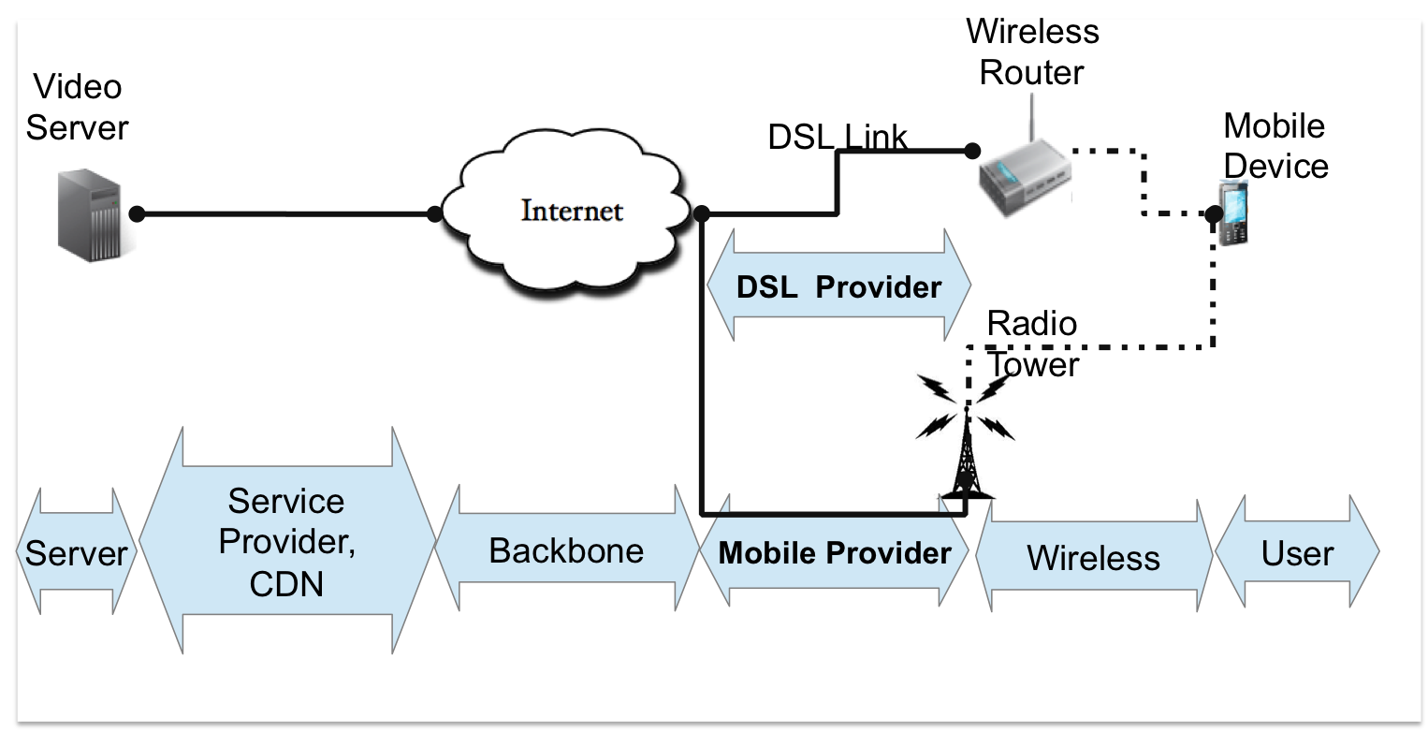
Communication networks are constantly growing in both size and complexity.
The traffic demands are increasing while new network applications emerge on daily basis.
Network measurements are the only way to gain understanding on how the networks are working and whether network resources are running low.
This lecture surveys the field of network measurement.

Slide 3
Network measurements are becoming crucial for the operation and security of the Internet, and of several services including application-level multicast trees, content distribution and peer-to-peer (P2P) systems.
Numerous tools for estimating network performance have been proposed (e.g., bandwidth measurement: latency: traceroute, ping, link quality etc.).
Most of these tools push the measurement function to the end-hosts, thus conforming to the well-known end-to-end principle that suggests the move of functions closer to the applications and to the end-hosts

Slide 4
Measurement Metrics
To determine the performance of the network, multiple different measurement metrics are to be measured.
The most typical metrics are:
      Connectivity,
      Latency,
      Packet Loss Rate,
      Bandwidth, and
      Throughput.
In addition, traffic behavior analyses can be made.
Connectivity, also known as reachability, is the most basic measurement metric.

Slide 5
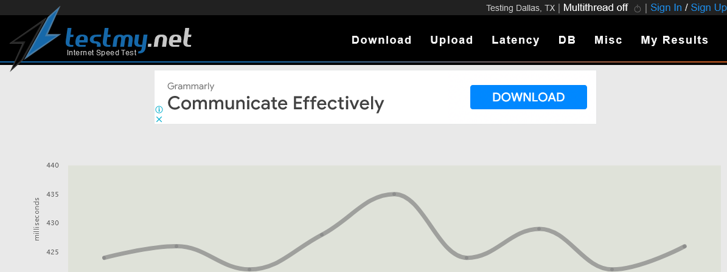
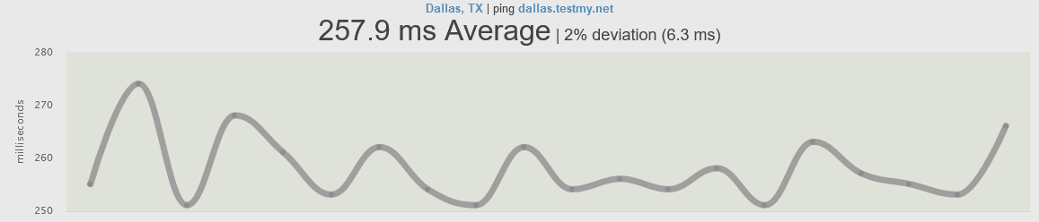
What is Latency?
Latency is the amount of time it takes for a computer or application to respond to your request. The less time it takes the better.
This is a test where you want to score low and there's a theoretical limit to how low you can go.
Absolute zero is impossible on this test.

Slide 6
Latency, referred as network delay, is the time it takes for a packet to arrive from the source host to the destination host.
The total end-to-end network delay is actually a product of several different types of delays:
    Processing Delay,
    Transmission Delay,
    Propagation Delay And
    Queuing Delay.
Processing delay is the total time it takes for all the routers in the network path to process the packet.
In IP network, the processing includes decrementing packet’s Time to Live variable by one, check that the IP header checksum matches the header and to decide where the packet is forwarded.

Slide 7
Transmission delay is the time it takes to send the packet through the link.
The time is affected by the bit rate of the link.
Propagation delay is the time it takes for the physical signal to travel over the transmission medium.
Queuing delay is the time the packet spends in buffers of the routers in the network path.
Latency can be measured either as one-way or two-way delay.
Two-way delay, also known as round-trip time (RTT), is easier to measure as only a single host needs to measure the time between the initial packet and the response.
To measure one-way delay, both the source and the destination hosts have to cooperate and be synchronized.

Slide 8
Packet loss rate is the rate at which packets are being lost in their transit from the source to the host.
Packet being lost means that the packet does not arrive to the intended destination.
To keep the network application usable, there is often some kind of timeout mechanism for lost packets to trigger retransmission.
If the retransmission timeout is reached before the packet arrives, the packet is regarded as lost even if it eventually would arrive to the destination.
Packet loss is an important metric, because it may have a dramatic impact on the performance of an application.

Slide 9
The packet loss rate is often very different for the same path in opposite directions.
With simple echo-reply measurement tools like Ping, it is not possible to define whether the original echo packet was lost or the response.
To measure forward loss (source to destination) and reverse loss (destination to source) separately, more advanced tools are needed.
Loss asymmetry is important because many protocols have a different level of fault tolerance for forward and reverse directions.
For example, TCP is far more tolerant for losing an acknowledgment packet than a data packet.

Slide 10
Bandwidth is a two-fold term: the term is used to describe either the physical link capacity in terms of signaling or the maximum actual data rate of a specific network link or a path can transfer.
To the data rate in a link or a path, there are three measurable metrics associated:
      Total capacity,
      Available bandwidth, and
      Bulk transfer capacity (BTC).
Total capacity refers to the maximum possible bandwidth the link or a path can transfer.
Available bandwidth refers to maximum unused bandwidth of a link or path during a certain time period.
Bulk transfer capacity refers to achievable throughput of an established TCP connection.

Slide 11
Throughput is a measure for amount of data actually being transferred across a link or network at a certain time.
Traffic is not exactly a metric, but something that can be collected from the network and analyzed.
Traffic analysis is used to determine the composition of the current traffic in the network.
Information is useful for capacity planning, traffic accounting and network security.
In addition to traffic behavioral analyses, several other measurement metrics can be determined by the analysis: for example packet loss, available bandwidth and throughput.

Slide 12
Passive Network Measurements
Passive network measurement tools rely on monitoring existing traffic between end-hosts to extract their estimates.
These tools are scalable since they do not generate extra traffic for measurement purposes.
Most current tools use packet capture libraries to monitor traffic and to extract various metrics of interest.
Several tools for passive measurements exist, such as Nettimer (for bandwidth estimation), Viznet (for throughput tests), Sting (for latency tests), etc..
However, passive measurement tools are finding less applicability nowadays due to the fact that existing traffic is not suitable for them to produce an indicative estimate.

Slide 13

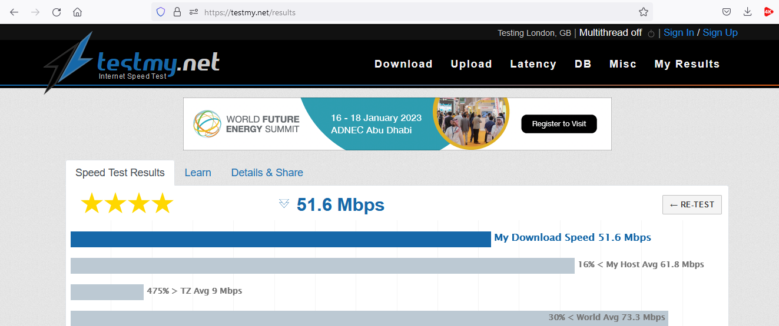
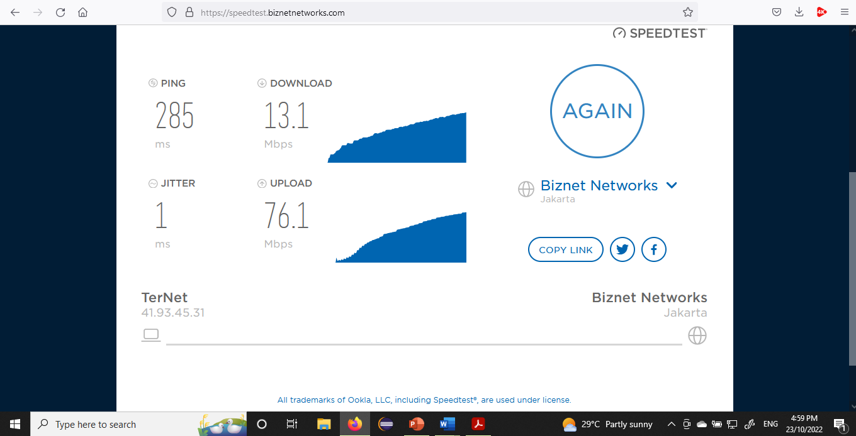

Slide 14
Active Network Measurements
A large number of tools actively generate probe traffic to extract their estimates about the network state.
Most of these tools are single-ended and do not require cooperation from the measured host.
Examples include Pathchar, and Sprobe measuring the bottleneck bandwidth, Cprobe and Spruce measuring the available bandwidth.
Several other tools aim at measuring the roundtrip times (RTT), latency, delay and the throughput of an end-to-end path, such as traceroute, mtr, ping.

Slide 15

Network Administrators need to know what's happening with their devices all the time be it to view the available resources that the administrator have or to view the bandwidth usage
Available tools are:
Paessler PRTG Network Monitor
SolarWinds Network Performance Monitor
Network Lookout Net Monitor

